Slide 1


Slide 2

Greenhouse and Greenhouse Effect

Slide 3
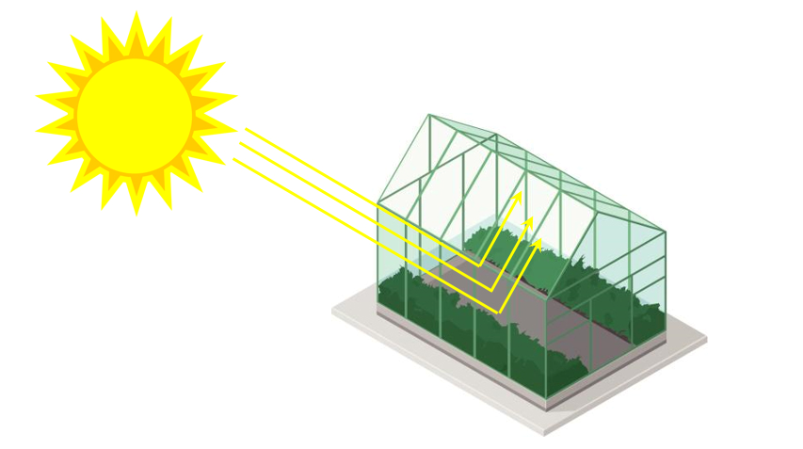

Slide 4


Slide 5
Important Terms

Slide 6
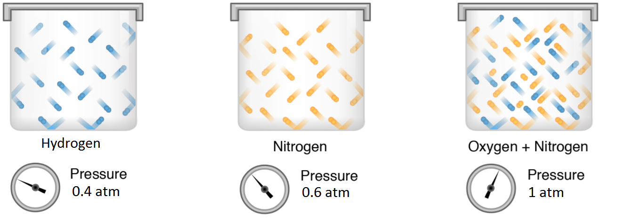
Partial pressure
Oxygen

Slide 7
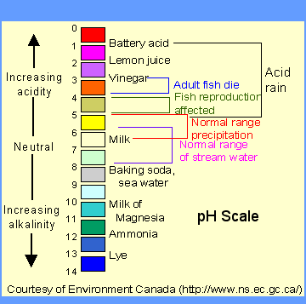
Potential of Hydrogen (pH)
Measurement of how acidic or basic an aqueous solution is. It ranges from 0 to 14, the lower being more acidic and higher means more basic

Slide 8
Acid
Substance that donates hydrogen ions. An acidic solution has more hydrogen ions than hydroxide ions

Slide 9
Base
Substance that accepts hydrogen ions. A basic solution has more hydroxide ions than hydrogen ions

Slide 10
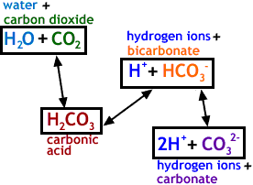
Bicarbonates and Carbonates
Products of dissociation of hydrogen ions of carbonic acid

Slide 11
Does the concentration of greenhouse gases, specifically carbon dioxide, affect the acidity of rainwater?

Slide 12
Problem proper
$$ρ_{CO2}=0.011825{\left(t−1980.5\right)}^{2}+1.356975\left(t−1980.5\right)+339$$
Where $ρ_{CO2}$ = partial pressure of $CO_{2}$ in the atmosphere (ppm)

Slide 13
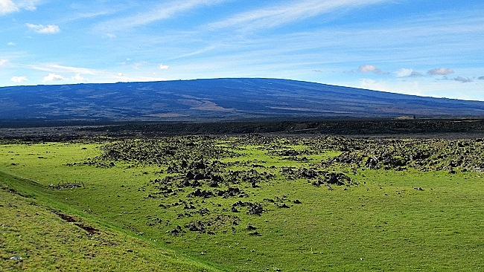
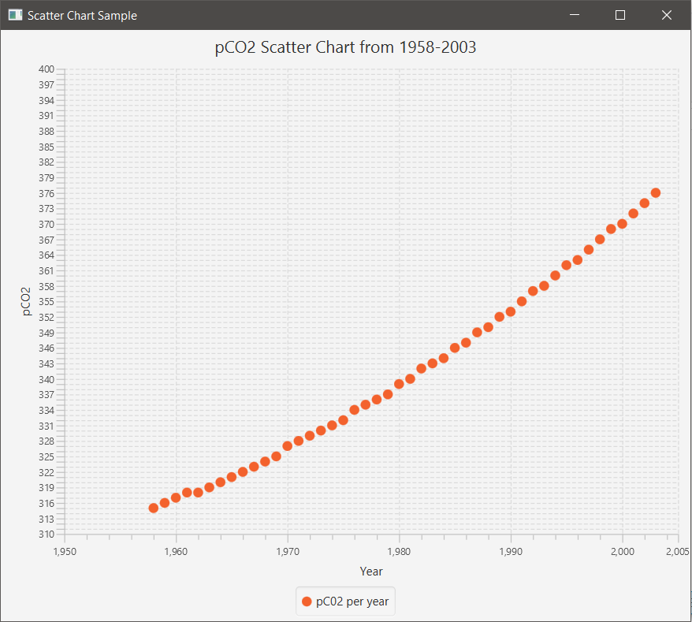
Partial pressure of co₂ of Mauna Loa in Hawaii (1958-2003)
Graph shows that the function is increasing and has not yet hit a plateau.

Slide 14
Problem proper
For Dilute Aqueous solutions, pH can be computed as:
$$pH=−log_{10}\left[H^{+}\right]$$

Slide 15



Non-linear Equations
$$\left(1\right) K_{1}={10}^{6}\frac{\left[H^{+}\right]\left[HCO_{3}^{−}\right]}{K_{H}ρ_{CO2}}$$
$${\left(2\right) K}_{2}=\frac{\left[H^{+}\right]\left[HCO_{3}^{2−}\right]}{{HCO}_{3}^{−}}$$
$${\left(3\right) K}_{w}=\left[H^{+}\right]\left[OH^{−}\right]$$
$${\left(4\right) C}_{T}=\frac{K_{H}ρ_{CO2}}{{10}^{6}}+\left[HCO_{3}^{−}\right]+\left[CO_{3}^{2−}\right]$$
$$\left(5\right) 0=\left[HCO_{3}^{−}\right]+2\left[CO_{3}^{2−}\right]+\left[OH^{−}\right]−\left[H^{+}\right]$$

Slide 16



Non-linear Equations
$$\left(6\right) \left[HCO_{3}^{−}\right]=\frac{K_{1}}{{10}^{6}\left[H^{+}\right]}K_{h}ρ_{CO2}$$
$$\left(7\right) \left[CO_{3}^{2−}\right]=\frac{K_{2}\left[HCO_{3}^{−}\right]}{\left[H^{+}\right]}$$
Substituting (6) to (7):
$$\left(8\right) \left[CO_{3}^{2−}\right]=\frac{K_{2}K_{1}}{{10}^{6}{\left[H^{+}\right]}^{2}}K_{h}ρ_{CO2}$$

Slide 17
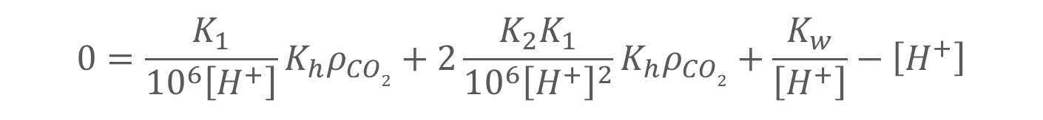
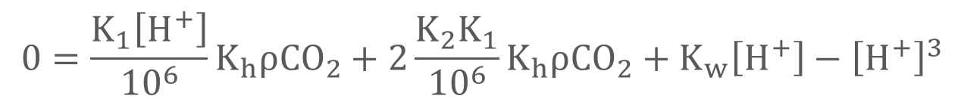
Non-linear Equations
Equations (6) and (7) can be substituted along with Eq. (3) into Eq.(5):
$$0=\frac{K_{1}}{{10}^{6}\left[H^{+}\right]}K_{h}ρ_{CO2}+2\frac{K_{2}K_{1}}{{10}^{6}{\left[H^{+}\right]}^{2}}K_{h}ρ_{CO2}+\frac{K_{w}}{\left[H^{+}\right]}−\left[H^{+}\right]$$
$${\left[H^{+}\right]}^{2}\left(0=\frac{K_{1}}{{10}^{6}\left[H^{+}\right]}K_{h}ρCO_{2}+2\frac{K_{2}K_{1}}{{10}^{6}{\left[H^{+}\right]}^{2}}K_{h}ρCO_{2}+\frac{K_{w}}{\left[H^{+}\right]}−\left[H^{+}\right]\right)$$
$$0=\frac{K_{1}\left[H^{+}\right]}{{10}^{6}}K_{h}ρCO_{2}+2\frac{K_{2}K_{1}}{{10}^{6}}K_{h}ρCO_{2}+K_{w}\left[H^{+}\right]−{\left[H^{+}\right]}^{3}$$

Slide 18
Root Finding Method
Since it was stated in the problem that the pH levels of rain water in pristine areas range from 2-12, we can use these as the bounds for our root-finding methods. We used Bisection Method.

Slide 19
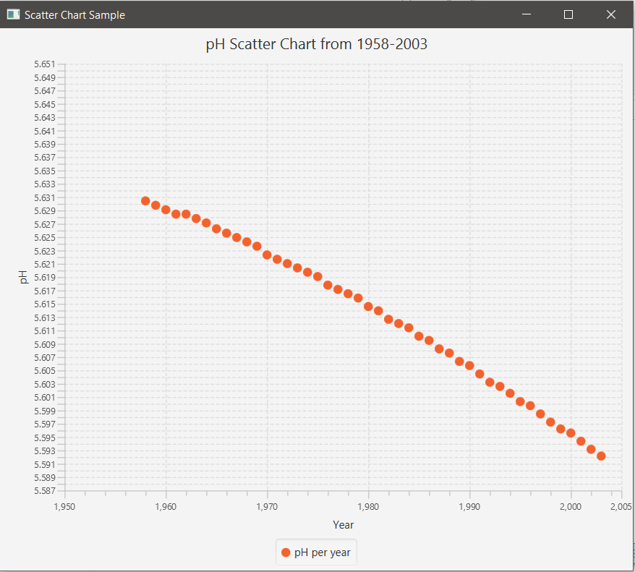
pH of rainwater in Mauna Loa in Hawaii (1958-2003)
Graph shows that the function is decreasing in pH, meaning that the rainwater in Mauna Loa is becoming more acidic as the partial pressure of C02 increases

Slide 20
pH of rainwater in Mauna Loa in Hawaii (1958-2003)

Slide 21
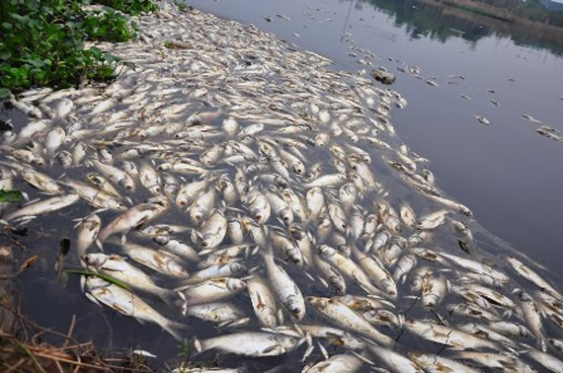
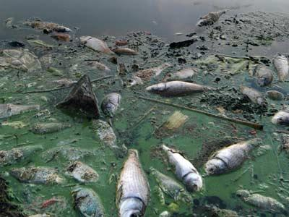
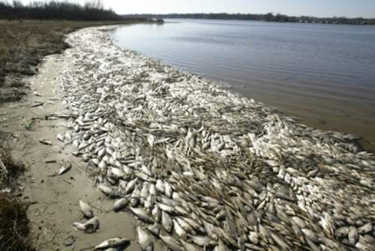
Effects of Acid rain
On animals, specifically aquatic animals some aquatic animals die because of the change in the ph of their habitat, causing a chain reaction of starvation among the predators that prey on the aquatic animals.

Slide 22
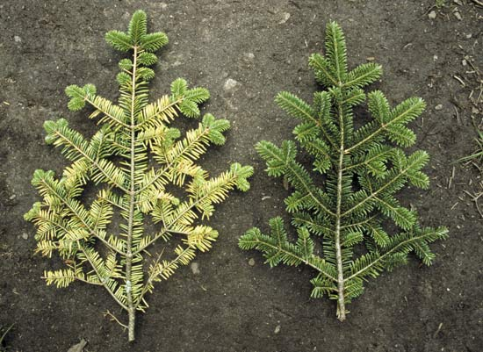
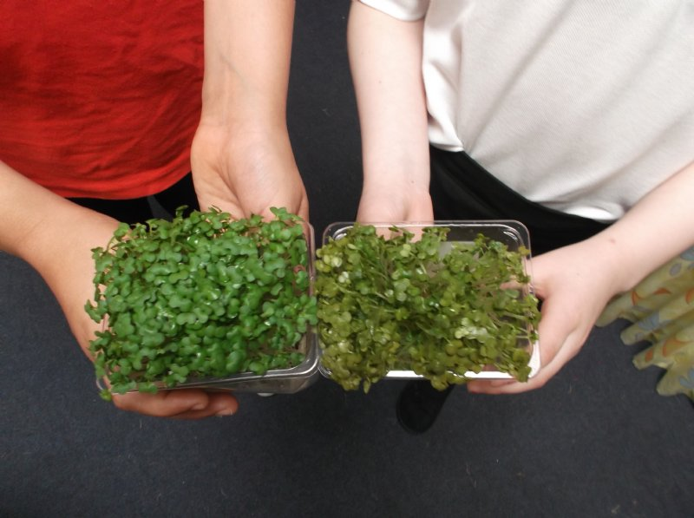
Effects of Acid rain
On plants, acid rain leeches nutrients off the soil, affecting the trees with malnourishment and if ph is low enough, direct damage to the leaves of the tree/plant.

Slide 23
Effects of Acid rain
Acid rain has no direct effect on humans, but humans are reliant on the environment, which can be affected by it. Also, acid rain indicates that the level of greenhouse gases are high, and if inhaled, can be harmful to the body.

Slide 24
Effects of Acid rain
Acid rain has no direct effect on humans, but humans are reliant on the environment, which can be affected by it. Also, acid rain indicates that the level of greenhouse gases are high, and if inhaled, can be harmful to the body.

Slide 25
Conclusion

Slide 26
Philippines vs Climate Change
On 2009, the Philippines passed Republic Act No. 9729 or Climate Change Act.
Aims to encourage all communities to take part and reduce and maximize the effect of climate change.
Aims to reduce greenhouse gases emissions as in accordance with the United Nations Framework Convention on Climate Change

Slide 27
Recommendations
Reduce, Reuse, Recycle
Conserve Energy
Help plant trees
Raise awareness

Slide 28
References
https://fmss12uchemd.wordpress.com/2013/05/07/bicarbonate-buffer-systems/
http://psf.climate.gov.ph/wp-content/uploads/2016/03/RIRR_RA9729_as_amended_by_RA10174.pdf
http://chemistry.elmhurst.edu/vchembook/184ph.html
https://chem.libretexts.org/Textbook_Maps/General_Chemistry_Textbook_Maps/Map%3A_ChemPRIME_(Moore_et_al.)/09Gases/9.11%3A_Dalton%27s_Law_of_Partial_Pressures
http://www.keywordlister.com/Z3JlZW5ob3VzZSBjbGlwIGFydA/
http://cliparting.com/free-earth-clip-art-11688/
https://www.explore-the-big-island.com/mauna-loa-volcano.html

